Slide 1
Making Training sessions productive yet Fun-filled

Slide 2


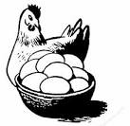



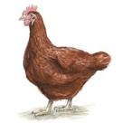

RDBMS: Co-related Sub query with Chicken-Egg example
Find the number of chickens who lay lesser number of eggs than the average number of eggs laid by chickens of her own type.
SELECT chicken_id,no_of_eggs_laid,chicken_weight
FROM Chicken_Table c1
WHERE no_of_eggs_laied < (SELECT AVG(no_of_eggs_laid)
FROM Chicken_Table c2
WHERE c1.type_id = c2.type_id );
Chicken_Table
Chicken_id | No_of_eggs_laid | Chicken_weight | Type_id (f-key)
C001 | 4 | 3.2 | T02
C002 | 6 | 1.5 | T01
Chicken_Type_Table
type_id( p-key) | type_Name | Price_per_kg
T01 | Broiler Chicken | 300
T02 | Country Chicken | 500
T03 | Layer Chicken | 400

Slide 3



Exception Handling in Polymorphism
Three different implementations of Mother handling exceptions by reacting in different ways when KidFelldownException occurs.
I was over confident on my Sac, I thought Exceptions would not occur. Now I learnt ,they do.
I am sorry darling. I lost control . I dropped you.
You naughty !!!
I told you to hold me properly. Now u fell down.
Mother Monkey
Mother Cat
Mother Kangaroo
interface Mother
{
public void carryKid() throws KidFelldownException;
}

Slide 4



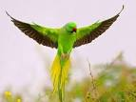
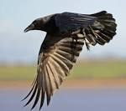
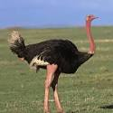
Method Overriding
abstract class Bird{
void fly()
{
//common Flying behavior implemented
} }
class Bird
class Eagle
class Pigeon
class Parrot
class Crow
class Ostrich
Ostrich inherits from Bird but prefers to have its own implementation of flying behavior
Class Ostrich extends Bird
{ @Override
void fly()
{
// Different implementation
} }

Slide 5




Composition Relationship
“ Perhaps U didn’t learn OOPs !!! Me and my heart have Composition relationship”
I made a mistake ,
I thought it was an aggregation relationship

Slide 6
Types of Examples & Demos that can get trainee’s attention the most
Demos from General Topics |  | From Business Scenarios
Whats App | Smartphones | Banking
Facebook | Hotel/PG | Social Networking
Food Items | Travel | Business Process Management
Movies | College | CRM -EFP
Friendship | Celebrations | Insurance
Music-Dance | Cartoon Characters | E-Governance
Money | TV serials | E-Commerce
Reality-shoes | Shopping | All types of web applications
Roadies | Robots | All types of Enterprise apps
Cricket | Actors | Mobile Apps and smartphones
Stories-Novel | Professions | Tabs
FIFA World Cup | Comedy | Demos can come from Almost every sector and businesses.

Slide 7
Thank You

